Slide 1


INFO5990 Professional Practice in IT Lecture 12A
Decision Making
Problem Solving
Decision Support Systems
Monitoring performance

Slide 2
Group assignment
22 marked
5HD
3D
12 Credit
2 Credit (had to try hard to get there)
3 not yet marked – wonder why ??

Slide 3
Next week
Guest Lecture Roberto Donat
Executive Manager - Westpac
IT Management in the real world
Review of the course
Exam tips – let your friends who do not come to class know !

Slide 4
By the end of this lecture you will be able to:
Understand the information cycle
Describe the classic phases of problem solving and decision making
Appreciate the characteristics of structured and unstructured decisions
Explain the nature and purpose of metrics and key performance indicators for performance monitoring
Understand the concept of a dashboard

Slide 5
Data & information Representing the real world

Slide 6






Data representation of the real world
BMJ 67R
Maserati
200 km/hour
Tiger, female, 150 kg
Chen Xian, 25 yrs
15 West St
Latitude 44.5 S
Longitude 135.4 E
Sunny, 34 Cº
The real world
Data representation

Slide 7






The information cycle
The real world
Observed facts
Knowledge
state
Encoding
Assimilation
Analog data
Output
Data representation
Report

Slide 8

Keeping in step
The real world
Data representation
42 East St
$340,000
R J Jones
20 Sep 2012
…
…
Events
Transactions
New data representation
Changed world
Is the new data representation correct?

Slide 9
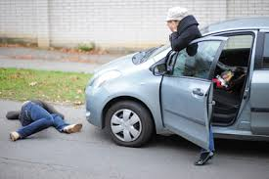
Problem solving A systems view
Case Study – the Pedestrian accident workshop

Slide 10
Problem Solving
A problem occurs when a system
does not meet its established goals
does not yield the predicted results, or
does not work as planned
To ‘solve the problem’ means ‘to reduce the difference between the desired outcome and the actual outcome’
Problem solving also includes the identification of new opportunities

Slide 11
Steps in problem solving
Define problem
Gather intelligence
This involves collecting information about the system
It may involve constructing a model of the system, which could be concrete or mathematical
Consider possible solutions to the problem and evaluate them
Choose preferred solution (can depend on objectives)
Implement the solution
Monitor success or otherwise of chosen solution

Slide 12
Satisficing
A ‘good enough’ solution
Decision maker is satisfied with a reasonable level of performance as opposed to the “best” possible
May be sub-optimal but can be arrived at much more quickly
Simon’s idea of ‘bounded rationality’

Slide 13
Spectrum of problems
STRUCTURED
UNSTRUCTURED
Well-defined
All relevant data known
Encountered before
Involving only one or a few people
Involving one or two disciplines
Standard models exist
Ill-defined
Not all data known
Never encountered before
Involving several stakeholders
Involving many disciplines
No known models
SEMI-STRUCTURED
Partially-defined
Some relevant data known
Similar problems met
Can be decomposed
Standard models exist for some parts

Slide 14
Question 1
A problem occurs in a system or organisation when the system
does not meet its established goals
does not yield the predicted results
does not work as planned
(D) ceases to function
(E) ANY of the above

Slide 15
Question 2
Which of the following best describes the process of problem solving?
(A) Finding someone to blame
(B) Identifying the cause of disruptions
(C) Choosing the best option for each action
(D) Overcoming discrepancies between actual and desired outcomes
(E) Being satisfied with a reasonable level of performance as opposed to the “best”

Slide 16
Management Decision Making and Management Science

Slide 17
Management
Management is a process by which organizational goals are achieved by strategic use of available resources
Inputs: resources – labour and materials
Output: attainment of goals
Measure of success: outputs – inputs
Managers have to decide on best course of action in order to solve problems
This involves making a decision

Slide 18
so, Management consists largely of Decision Making
Management science is a discipline through which managers can improve their decision making by exploiting computer methods and techniques.

Slide 19
Decision making is not getting any easier
More alternatives from which to choose
globalization, advanced information systems, internet, search engines, rapidly changing technology, business intelligence
Uncertainty makes it more difficult to predict
political instability, global crisis, terrorism, changes to government regulations, increased competition, changing consumer demands
Greater need to make decisions rapidly
the faster decisions are made, the greater the chance of error
but potential cost of making mistakes is high
‘trial-and-error’ learning too difficult and too costly

Slide 20
Dimensions of decision making
Rational
Quantitative
Logical
Mathematical Optimising
Organisational
Policy
Rules
Peer pressure
Corp. image
Political
Politicians
Public opinion
Unions
Legal

Slide 21
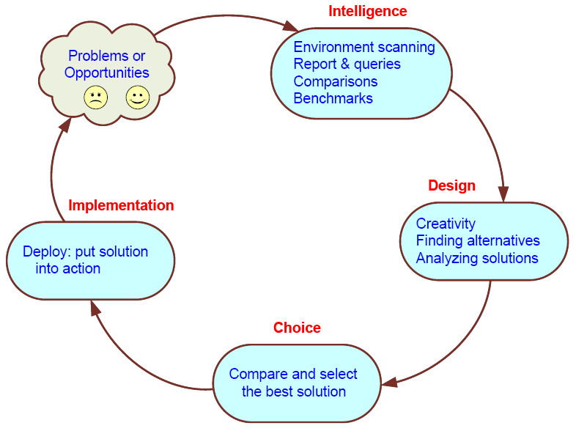
The rational decision making cycle (Simon, 1977)

Slide 22
Decision making v. problem solving
Decision making and problem solving follow essentially the same steps
So, problem solving, decision making and management are essentially the same thing

Slide 23
Structured v. Unstructured Decisions
Structured decisions may be automated
e.g. place an order when stock level reaches reorder level, with reorder quantity based on three month moving average
Unstructured/semi-structured problems often require customized solutions
may need to be subdivided and reorganized
may be partially supported by computerized quantitative methods
may involve intuition and judgment

Slide 24
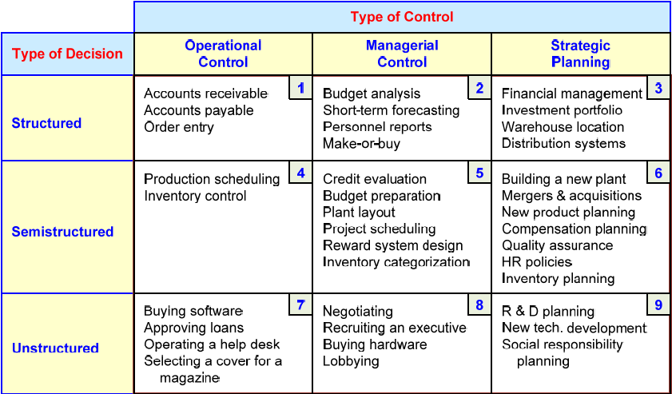
Range of decision types (Gory and Scott-Morten, 1971)

Slide 25
Decision Support Systems
An interactive computer-based system, which helps decision makers utilize data and models to solve unstructured problems Gorry and Scott-Morton, 1971
A computer-based support system for management decision makers who deal with semi-structured problems A DSS couples the intellectual resources of individuals with the capabilities of the computer to improve the quality of decision making Keen and Scott-Morton, 1978
i.e. facilitates the Application of Management Science

Slide 26
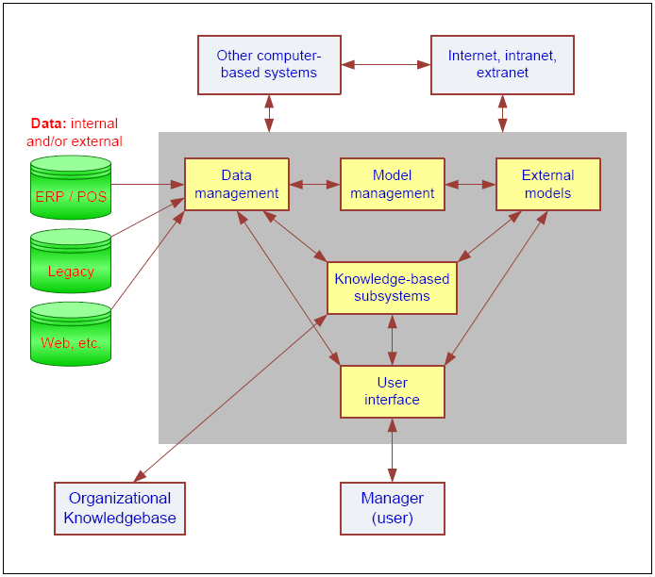
Components of classical DSS

Slide 27
Question 3
Which of the following is NOT always a step in decision making?
Define the problem
Gather intelligence
Consider possible solutions
Choose optimal solution
Implement decision

Slide 28
Modelling reality

Slide 29
Modeling reality
The real world is too complex to describe, but, much of the complexity may be irrelevant to solving a specific problem
A model is a representation of reality incorporating some essential aspects of an object or event

Slide 30


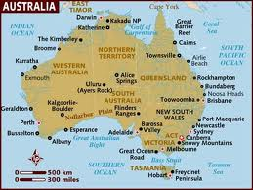
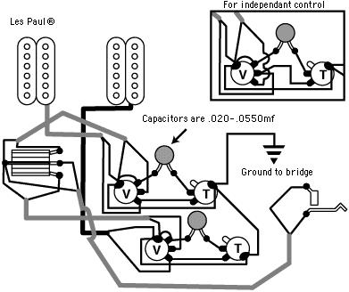
Classification of Models
Physical
Iconic: scale models, test dummies
Schematic: maps, diagrams
Symbolic
verbal description,
financial statement,
specification
Mathematical
equation or formula
representing problem space at various degrees of abstraction

Slide 31
Benefits of Mathematical Models
Easy to manipulate
Facilitate compression of time
Permit evaluation of many alternatives, “what-if” analysis, goal seeking
Cheaper than building scale models
No cost for making mistakes in experiments
Also possible to build in risk and uncertainty (stochastic models)

Slide 32
Classical mathematical models

Slide 33
Optimization models
Linear programming
Constraints define a feasible solution space
Objective function defines the object of the optimization
Allows sensitivity analysis
Very useful in ‘product mix’ problems

Slide 34
Example: Manufacturing Company
 | Tractors | Cars | Limited number of Hours Available
Profit Contribution | $7 ‘000 | $5 ‘000
Finishing | 3 hrs | 4 hrs | 2400
Testing | 2 hrs | 1 hr | 1000
Other constraints:
Orders for at least 100 tractors
Materials for no more than 450 cars

Slide 35
Simulation models
Queuing
Can identify bottlenecks, say in production lines, or check out queues
Assume some kind of probability distribution (e.g. Poisson or exponential distribution)
Monte Carlo
Assume some input probability distribution, e.g. normal, triangular
Model generates output probability distribution rather than a single value, e.g. critical path with stochastic events

Slide 36
‘What if’ analysis
Input parameters of the model varied to see what is the resultant output
Easy to test a wide range of possible inputs
Demo: ‘Research Portfolio’ example in Supplementary material for week 12

Slide 37
‘What if’ analysis (1)
RESEARCH PROJECT PORTFOLIO
Running Expenses Ratio | 10%
Total Budget | $1,200,000
 |  | Personnel Requirements
 | Salary $ | Algae | Ragweed | Trout | Platypus
Chief Scientist | 90,000 | 1 | 1 | 1 | 1
Research Scientist | 75,000 | 2 | 1 | 1 | 2
Trainee Scientist | 38,000 | 3 | 2 | 0 | 1
Technician | 23,000 | 2 | 6 | 4 | 4
Total Salaries |  | 400,000 | 379,000 | 257,000 | 370,000
Running Expenses |  | 40,000 | 37,900 | 25,700 | 37,000
Total Cost |  | 440,000 | 416,900 | 282,700 | 407,000
Vote Equivalent (VE) |  | 73,000 | 66,000 | 31,000 | 37,000
Chosen/Not Chosen |  | 1 | 1 | 1 | 1
Portfolio Total Cost | 1,546,600
Portfolio Vote Equivalent | 207,000
Within Budget (Y/N)? | Over budget

Slide 38
‘What if’ analysis (2)
RESEARCH PROJECT PORTFOLIO
Running Expenses Ratio | 10%
Total Budget | $1,200,000
 |  | Personnel Requirements
 | Salary $ | Algae | Ragweed | Trout | Platypus
Chief Scientist | 90,000 | 1 | 1 | 1 | 1
Research Scientist | 75,000 | 2 | 1 | 1 | 2
Trainee Scientist | 38,000 | 3 | 2 | 0 | 1
Technician | 23,000 | 2 | 6 | 4 | 4
Total Salaries |  | 400,000 | 379,000 | 257,000 | 370,000
Running Expenses |  | 40,000 | 37,900 | 25,700 | 37,000
Total Cost |  | 440,000 | 416,900 | 282,700 | 407,000
Vote Equivalent (VE) |  | 73,000 | 66,000 | 31,000 | 37,000
Chosen/Not Chosen |  | 0 | 1 | 1 | 1
Portfolio Total Cost | 1,106,600
Portfolio Vote Equivalent | 134,000
Within Budget (Y/N)? | OK

Slide 39
Goal seeking
Given the desired value of the output, find out what value of input is required
Example: If I do not want to have to repay any more than $900 a month on a loan of $100,000, what interest rate do I require?
Excel function PMT gives payments on a given loan based on equal payments = PMT ( rate, number of periods, $ loan)

Slide 40
Warning Should you trust Mathematical Models?
Users begin to ‘believe’ in their model
Results are only as good as the model
Essential aspects of reality may be inadvertently omitted
Relationships between variables may not be ‘true to life’
Benefits are not real $ until the plan is implemented and profit is realised

Slide 41
Question 4
An optimization model is one which
allows ‘what if’ analysis
facilitates goal seeking
has an objective function that defines the object of the optimization
uses a ‘rule of thumb’ to find an optimal solution
BOTH (A) and (B)

Slide 42
Question 5
In problem solving, a ‘heuristic’ is an approach which
uses a ‘rule of thumb’ to find an initial feasible solution
can work where all other approaches fail
is an example of ‘what if’ analysis
is an example of a goal seeking function
BOTH (A) and (B)

Slide 43
More about monitoring organisation performance
Metrics and
key performance indicators

Slide 44
“If you don’t measure it, you can’t manage it!”
W. Edwards Deming
"Seven Deadly Diseases" facing management:
Lack of constancy of purpose
Emphasis on short-term profits
Evaluation by performance, merit rating, or annual review of performance
Mobility of management
Running a company on visible figures alone
Excessive medical costs
Excessive costs of warranty, fueled by lawyers who work for contingency fees

Slide 45
Types of metrics
Financial metrics
sales, profit, return on investment
Quantitative metrics
earned value, planning hours as a percentage of total labour
Qualitative metrics
improved efficiency, employee morale, client satisfaction
Directional metrics
trends: showing whether getting better or worse
End result or success metrics
number of clients seen, products finished
Actionable metrics
number of unstaffed hours, positions unfilled
Milestone metrics
work packages completed by June, safety record this year

Slide 46
Key performance indicators
A KPI is a metric that is tied to a target
KPIs provide information on controllable factors appropriate for informed decision-making
KPIs should be
Relevant: relate to some important aspect of business
Indicative: reflect success or failure of business
Measurable: can be expressed quantitatively
Predictive: able to predict the future of a particular trend
Understood: known relationship to performance

Slide 47
Choose the best KPI for you
cost or schedule performance index (CPI or SPI)
customer satisfaction,
employee satisfaction,
value of new business,
net profit before tax,
return on investment,
comparison of this period with last period
net cash flow,
expenses as a ratio to revenue,
health and safety record,
manufacturing capacity and operational efficiency

Slide 48
Difficulties encountered with KPIs
Lack of agreement among stakeholders
Not understood by stakeholders
Not trusted by stakeholders
Can effect team behaviour
Team members believe that they are being spied on by management

Slide 49
The Balanced Scorecard (1992)
“A set of measures that gives top management a fast but comprehensive view of the business.”
Complements the usual financial measures with various operational measures that are the drivers of future financial performance:
customer satisfaction, internal processes, market success, innovation and improvement activities
“Think of the balanced scorecard as the dials and indicators in an airplane cockpit.”
Kaplan, R.S., and D.P. Norton, 1992 The Balanced Scorecard: Measures that drive performance, Harvard Business Review (January-February): 71-79

Slide 50
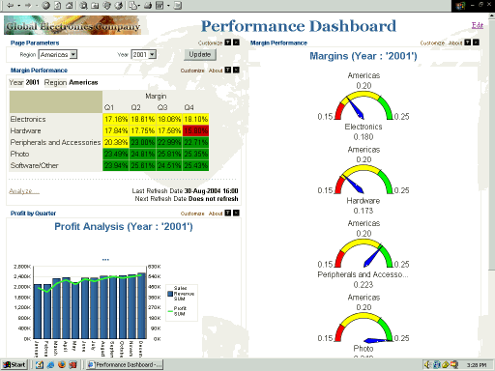
The dashboard (2012)

Slide 51
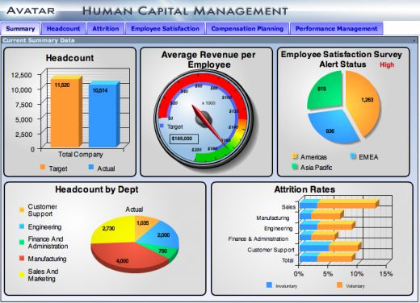
Another example of a dashboard

Slide 52
Dashboard
"An easy to read, often single page, real-time user interface, showing a graphical presentation of the current status (snapshot) and historical trends of an organization’s Key Performance Indicators (KPIs) to enable instantaneous and informed decisions to be made at a glance.”
Peter McFadden CEO of ExcelDashboardWidgets , "What is Dashboard Reporting“
http://www.schacterconsulting.com/documents/dashboard.pdf
http://en.wikipedia.org/wiki/Dashboard_(management_information_systems)

Slide 53
Question 6
Write down your score
A ‘dashboard’ in a Decision Support System is best described as
(A) an optimization model of the organization
(B) a graphical presentation of the current status of an organisation
(C) a display of a key performance indicators
(D) a display of ‘what if’ analysis results
(E) a mechanism for improving management performance

Slide 54
Benefits of dashboards
Facilitate recognition of problems before they lead to other problems
Offer opportunity for early corrective action
Help avoid
escalating costs
deteriorating value of benefits
missed deadlines
schedule slippages that cannot be corrected

